Slide 1

Macroeconomics
Ninth Canadian Edition
Chapter 9
The IS–LM–FE Model: A General Framework for Macroeconomic Analysis
Copyright © 2022 Pearson Canada Inc.
Notes:
If this PowerPoint presentation contains mathematical equations, you may need to check that your computer has the following installed:
1) MathType Plugin
2) Math Player (free versions available)
3) NVDA Reader (free versions available)

Slide 2
Main Questions
What factors determine equilibrium in labour market? (FE Line)
What factors determine equilibrium in goods market? (IS Curve)
What factors determine equilibrium in assets market? (LM Curve)
What is general equilibrium in IS-LM-FE model and how prices adjust to attain it?

Slide 3
Introduction to the IS-LM Model
Name originates from basic equilibrium conditions
  Investment, I, must equal saving, S
  Money demanded, L, must equal money supplied, M
First developed by Keynesians
Can be used to represent both classical and Keynesian models

Slide 4
The FE Line: Equilibrium in the Labour Market
Equilibrium in the labour market is represented by full-employment line, FE.
When the labour market is in equilibrium, output equals its full-employment level, regardless of the interest rate (FE line is vertical).

Slide 5
Factors that Shift the FE line
The full-employment level of output, , is determined by the current level of labour, capital, and productivity.
For classical economists the full-employment level of output is affected by government spending.

Slide 6
The IS Curve: Equilibrium in the Goods Market (1 of 2)
The IS curve shows for any level of output (income), Y, the interest rate, r, for which the goods market is in equilibrium.
The IS curve slopes downward.
At all points on the curve I = S.

Slide 7
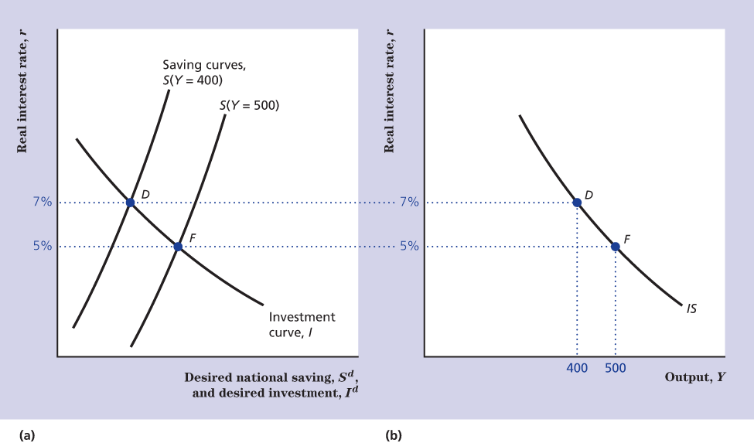
The IS Curve: Equilibrium in the Goods Market (2 of 2)
Figure 9.2 Deriving the IS Curve

Slide 8
Factors That Shift the IS Curve (1 of 3)
For constant output, any change in the economy that reduces desired national saving relative to desired investment will increase the real interest rate that clears the goods market and shift the IS curve.

Slide 9
Factors That Shift the IS Curve (2 of 3)
The IS curve in terms of goods equilibrium condition (AD = AS): For a given level of output, any change that increases the aggregate demand for goods shifts the IS curve up.

Slide 10
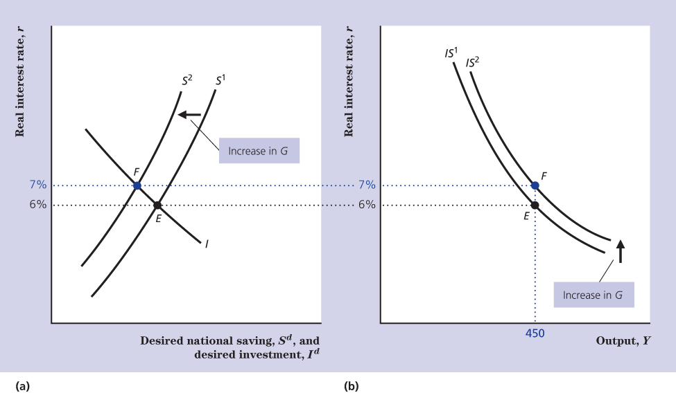
Factors That Shift the IS Curve (3 of 3)
Figure 9.3 Effect on the IS Curve of a Temporary Increase in Government Purchases

Slide 11
The Price of a Nonmonetary Asset and the Interest Rate (1 of 2)
Given the promised schedule of repayments of a bond or other nonmonetary asset, the higher the price of the asset, the lower is the nominal interest rate of the asset.

Slide 12
The Price of a Nonmonetary Asset and the Interest Rate (2 of 2)
For a given rate of inflation the price of a nonmonetary asset and its real interest rate are also inversely related.

Slide 13
The Equality of Money Demanded and Supplied (1 of 2)
The real money supply curve (MS) is a vertical line; it does not depend on the real interest rate.
The money demand curve (MD) slopes downward. With higher r the attractiveness of money as an asset decreases.

Slide 14
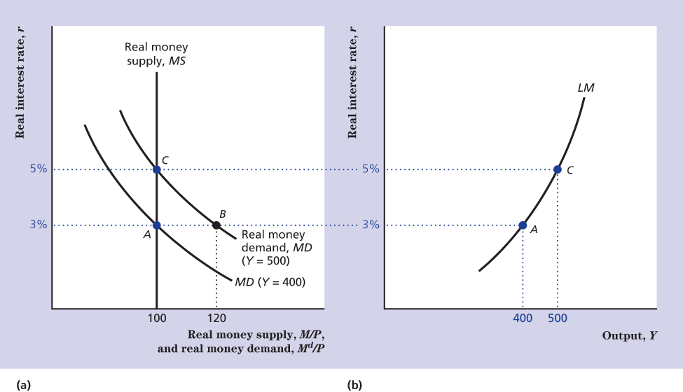
The Equality of Money Demanded and Supplied (2 of 2)
Figure 9.4 Deriving the LM Curve

Slide 15
The LM Curve: Asset Market Equilibrium
The LM curve is a graphical representation of the relationship between output and the real interest rate that clears the asset market.
The LM curve slopes upward.
At all points of the curve MD = MS.

Slide 16
Factors that Shift the LM Curve
For constant output, any change that reduces the real money supply relative to the real demand for money, will increase the real interest rate that clears the asset market, and cause the LM curve to shift up.

Slide 17
Changes in the Real Money Supply (1 of 2)
An increase in the real money supply (M/P) will reduce r and shift the LM curve down.
With an excess supply of money holders of wealth try to purchase nonmonetary assets causing their price to go up and r to go down.

Slide 18
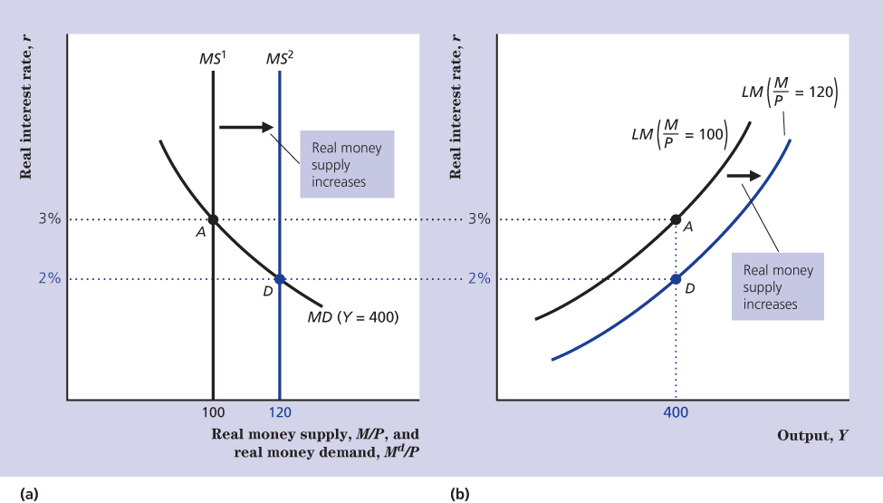
Changes in the Real Money Supply (2 of 2)
Figure 9.5 An Increase in the Real Money Supply Shifts the LM Curve Down and to the Right

Slide 19
Changes in the Real Money Demand (1 of 2)
A change in any variable that affects real money demand, other than output or real interest rate, will also shift the LM curve.

Slide 20
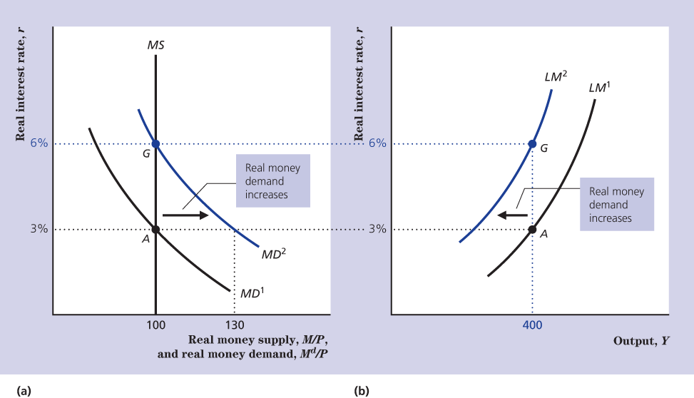
Changes in the Real Money Demand (2 of 2)
Figure 9.6 An Increase in Real Money Demand Shifts the LM Curve Up and to the Left

Slide 21
General Equilibrium in the Complete IS-LM-FE Model (1 of 3)
When the economy is in general equilibrium
  The FE line along with the labour market is in equilibrium.
  The IS curve, along with the goods market is in equilibrium.
  The LM curve, along with the asset market is in equilibrium.

Slide 22
General Equilibrium in the Complete IS-LM-FE Model (2 of 3)
The general equilibrium of the economy always occurs at the intersection of the IS curve and the FE line.

Slide 23
General Equilibrium in the Complete IS-LM-FE Model (3 of 3)
Adjustments of the price level cause the LM curve to shift until it passes through the general equilibrium point.

Slide 24
A Temporary Adverse Supply Shock (1 of 4)
Suppose the productivity parameter A in the production function drops temporarily.
It reduces the MPN and shifts the labour demand curve down. The labour supply curve is unaffected.
The FE line shifts left.

Slide 25
A Temporary Adverse Supply Shock (2 of 4)
A temporary adverse supply shock is a movement along the IS curve, not a shift of the IS curve.
A temporary adverse supply shock has no direct effect on the demand for, or the supply of money.

Slide 26
A Temporary Adverse Supply Shock (3 of 4)
The LM curve shifts until it passes through the intersection of the FE line and the IS curve.
For that to happen the M/P must fall, that is P should rise. A temporary supply shock should cause a temporary increase in the rate of inflation.

Slide 27
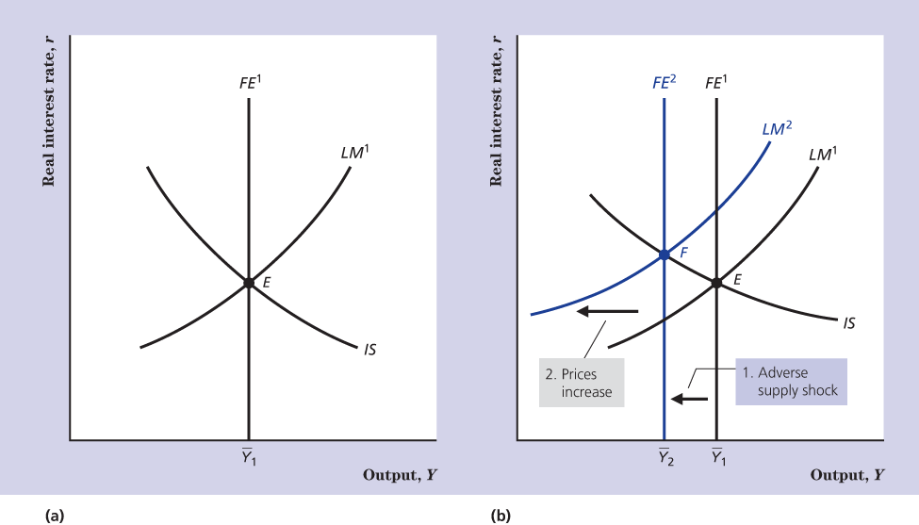
A Temporary Adverse Supply Shock (4 of 4)
Figure 9.8 Effects of a Temporary Adverse Supply Shock

Slide 28
The Effects of a Monetary Expansion (1 of 3)
Suppose that the central bank decides to raise M.
P is constant, so M/P increases.
The LM curve will shift down, the interest rate drops.
Only the asset market and the goods market are in equilibrium.

Slide 29
The Effects of a Monetary Expansion (2 of 3)
After the interest rate drops the aggregate demand for goods rises.
Assume that firms respond by increasing production leading to a higher output in the short-run equilibrium.

Slide 30
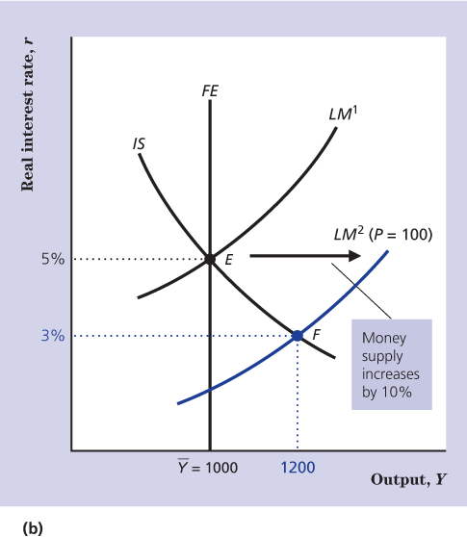
The Effects of a Monetary Expansion (3 of 3)
Figure 9.9 Effects of a Monetary Expansion (part b only)

Slide 31
The Adjustment of the Price Level (1 of 5)
In meeting the higher level of aggregate demand, firms are producing more output than they want to.
At some point firms begin to raise their prices and the price level rises.

Slide 32
The Adjustment of the Price Level (2 of 5)
As the price level rises the real money supply M/P becomes lower and the LM curve shifts up.
The LM curve keeps shifting until it is in its initial position, where the aggregate quantity of goods demanded equals full-employment output.

Slide 33
The Adjustment of the Price Level (3 of 5)
Thus, the change in the nominal money supply causes the price level to change proportionally.
The return of the economy to general equilibrium requires adjustment of nominal wages as well as adjustment of the price of goods.

Slide 34
The Adjustment of the Price Level (4 of 5)
In practice the money supply increases constantly and the price level increases accordingly.
Thus, an increase in the money supply means an increase relative to the expected (or trend) rate of money growth.

Slide 35
The Effects of a Fiscal Expansion (1 of 4)
Suppose the government choses to increase government purchases.
IS curve shifts up and interest rate increases.
Goods and asset markets are in equilibrium, but the labour market is not.

Slide 36
The Effects of a Fiscal Expansion (2 of 4)
Assume the central bank does nothing, so M doesn’t change. Since P is constant in short-run, M/P holds constant and LM curve doesn’t shift.
Firms produce extra output to meet the net increase in aggregate demand, so output rises.

Slide 37
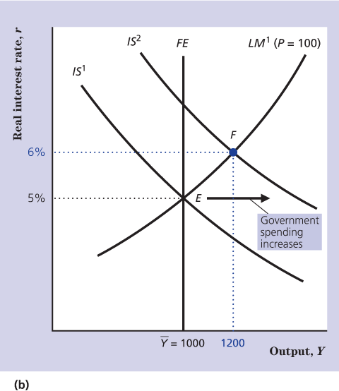
The Effects of a Fiscal Expansion (3 of 4)
Figure 9.10 Effects of A Fiscal Expansion (part b only)

Slide 38
The Effects of a Fiscal Expansion (4 of 4)
Short-run adjustment is a consequence of two influences
Multiplier Effect
  Initial changes in government purchases has multi-round effects on output.
Crowding out effect
  An increase in government purchases raise interest rate crowding out private investment.

Slide 39
The Adjustment of the Price Level (5 of 5)
Because aggregate demand exceeds full-employment output, the price level rises.
Increase in the price level reduces M/P and shifts the LM curve up to the left until the aggregate quantity of goods demanded equals full-employment output.

Slide 40
The Debate Between Classicals and Keynesians
Two central questions
  How rapidly does the economy reach general equilibrium?
  What are the effects of monetary policy on the economy?

Slide 41
Price Adjustment and the Self-Correcting Economy (1 of 2)
After an initial LM curve shift, the price level adjusts and shifts the LM curve back to the general equilibrium.
The classical assumption is that prices are flexible and the adjustment process is rapid.

Slide 42
Price Adjustment and the Self-Correcting Economy (2 of 2)
According to the Keynesian view, sluggish adjustment of prices might prevent general equilibrium from being attained for a much longer period of time.
The economy is not in general equilibrium and the labour market is not in equilibrium for an extended period.

Slide 43
Stabilization Policy
Unexpected shifts in the IS, LM and the FE curves are the sources of business cycles.
Stabilization policy is the use of fiscal and monetary policy to shift the position of the IS and LM curves so as to offset the effects of such shocks.

Slide 44
Monetary Neutrality
There is monetary neutrality if a change in the nominal money supply changes the price level proportionately but has no effect on real variables.
Keynesians believe in monetary neutrality in the long-run but not in the short-run.

Slide 45
The Aggregate Demand Curve
The aggregate demand curve shows the relation between the aggregate quantity of goods demanded (C^{d} + I^{d} + G) and the price level, P.
The AD curve slopes downward.

Slide 46
Factors That Shift the AD Curve (1 of 2)
For a constant price level
  Any factor that changes the aggregate demand for output will cause the AD curve to shift.
  Any factor that causes the intersection of the IS and the LM curves to shift will cause the AD to shift.

Slide 47
Factors That Shift the AD Curve (2 of 2)
Monetary and fiscal policy both shift the AD curve, so they are often referred to as aggregate demand policies.

