Slide 1
Macroeconomics
Ninth Canadian Edition
Chapter 10
Exchange Rates, Business Cycles, and Macroeconomic Policy in the Open Economy
Copyright © 2022 Pearson Canada Inc.
Notes:
If this PowerPoint presentation contains mathematical equations, you may need to check that your computer has the following installed:
1) MathType Plugin
2) Math Player (free versions available)
3) NVDA Reader (free versions available)

Slide 2
Main Questions
What are nominal and real exchange rate? How are they determined?
How does economic openness affect fiscal and monetary policies?
How do macroeconomic policy changes affect a country’s trading partners?
How do you choose an exchange rate system?

Slide 3
The Open Economy
Two aspects world economy interdependence:
International trade in goods and services
Worldwide integration of financial markets

Slide 4
Nominal Exchange Rates (1 of 2)
If someone in one country wants to buy goods, services, or assets from someone in another country, normally she will first have to exchange her currency for that of her trading partner’s country.

Slide 5
Nominal Exchange Rates (2 of 2)
The nominal exchange rate, or exchange rate, between two currencies, e_{nom}, is the number of units of foreign currency which can be purchased with a unit of the domestic currency.
e.g. if C$1 = ¥78 then e_{nom} = 78¥/C$

Slide 6
Exchange Rate Systems (1 of 2)
In a flexible-exchange-rate, or floating-exchange-rate, exchange rates are not officially fixed, but are determined by conditions of supply and demand in the foreign exchange market.
Under this system exchange rates adjust continuously.

Slide 7
Exchange Rate Systems (2 of 2)
In a fixed-exchange-rate system exchange rates are set at officially determined levels.
The official rates are maintained by the commitment of nations’ central banks to buy and sell their own currencies at the fixed exchange rate.

Slide 8
Real Exchange Rate (1 of 3)
The real exchange rate is the number of foreign goods someone gets in exchange for one domestic good.
Real exchange rates are based on price indexes of “baskets” of goods. We assume that each country produces a single good.

Slide 9
Real Exchange Rate (2 of 3)
e_{nom} is the nominal exchange rate
P_{For} is the price of foreign goods, measured in the foreign currency
P is the price of domestic goods, measured in nominal currency

Slide 10
Real Exchange Rate (3 of 3)
Suppose e_{nom} = 78¥ / C$, P_{for} = ¥312 and P = C$3

Slide 11
Appreciation and Depreciation (1 of 3)
Under a nominal depreciation the nominal exchange rate, e_{nom}, falls, a dollar buys less units of foreign currency, it becomes “weaker.”
Under a nominal appreciation the nominal exchange rate, e_{nom}, rises, a dollar buys more units of foreign currency, it becomes “stronger.”

Slide 12
Appreciation and Depreciation (2 of 3)
The terms “depreciation” and “appreciation” are associated with flexible exchange rates.
The fixed-exchange rate system equivalents are devaluation and revaluation.

Slide 13
Appreciation and Depreciation (3 of 3)
A real appreciation is an increase in the real exchange rate.
With real appreciation the same quantity of domestic goods can be traded for more foreign goods.
A real depreciation is a drop in the real exchange rate.

Slide 14
Purchasing Power Parity (1 of 3)
Purchasing Power Parity (PPP) says similar foreign and domestic goods, or baskets of goods, should have the same price in terms of the same currency (e = 1) – ignoring transportation and transaction costs.

Slide 15
Purchasing Power Parity (2 of 3)
PPP implies that
PPP holds in the very long-run

Slide 16
Purchasing Power Parity (3 of 3)

Slide 17
The Real Exchange Rate and Net Exports
Real exchange rate
Represents the rate at which domestic goods can be traded for foreign goods
Affects a country’s net export
The higher the real exchange rate, the lower a country’s net exports.

Slide 18
How Exchange Rates are Determined
The nominal exchange rate e_{nom} is the value of a currency, say the dollar, expressed in terms of the value of another currency.
The value of the dollar is determined by supply and demand in the foreign exchange market.

Slide 19
Demand for Dollars
Reasons to demand dollars (national currency)
To be able to buy Canadian goods
To be able to buy Canadian real and financial assets
The demand curve is downward sloping.

Slide 20
Supply of Dollars
Reasons to supply dollars (national currency)
To be able to buy foreign goods
To be able to buy real and financial assets in foreign countries
The supply curve is upward sloping

Slide 21
Effects of Changes in Output (Income) (1 of 2)
When domestic output (income) rises the demand for imports increases and net exports must fall.
The domestic currency depreciates, the exchange rate falls.

Slide 22
Effects of Changes in Output (Income) (2 of 2)
When foreign output (income) rises exports increase and net exports must rise.
The domestic currency appreciates, the exchange rate rises.

Slide 23
Effects of Changes in Export Quality
When the quality of Canadian goods increases, foreigners demand more of our goods and the demand for Canadian dollars rises.
This will shift the demand for dollars rightward.

Slide 24
Effects of Changes in Real Interest Rate (1 of 2)
If the domestic country’s real interest rate rises, other factors held constant, the country’s real and financial assets are more attractive for investment.
The demand for domestic currency increases and the exchange rate appreciates (e_{nom} rises).

Slide 25
Effects of Changes in Real Interest Rate (2 of 2)
After the domestic real interest rate rises, the exchange rate appreciation reduces net exports.
If the foreign country’s real interest rate rises the supply of domestic currency increases, the exchange rate depreciates, and the domestic country net exports rise.

Slide 26
Returns on Domestic and Foreign Assets (1 of 3)
In an open economy, savers have an opportunity to buy financial assets sold by foreign borrowers as well as those sold by domestic borrowers.

Slide 27
Returns on Domestic and Foreign Assets (2 of 3)
Investment decisions depend on
Nominal interest rates in foreign countries relative to those in the domestic economy
Expected changes to the exchange rate

Slide 28
Returns on Domestic and Foreign Assets (3 of 3)
The gross nominal rate of return on a foreign bond
e^{f}_{nom} is the expected future value of e_{nom}

Slide 29
Interest Rate Parity (1 of 4)
The difference in returns cannot persist for long; the nominal interest rates equalize.

Slide 30
Interest Rate Parity (2 of 4)
The equilibrium for the international asset market or nominal interest rate parity condition

Slide 31
Interest Rate Parity (3 of 4)
If the nominal exchange rate is expected to remain the same as its current value the nominal interest rate parity condition is:

Slide 32
Interest Rate Parity (4 of 4)
The real interest rate parity condition is:
For e = e^{f} the condition is r = r_{For}, which is the assumption we make in what follows next.

Slide 33
The IS-LM-FE Model for an Open Economy
Assume that the expected (trend) rates of growth in domestic prices and money supply are given.
Assume that the expected (trend) rate of growth in foreign prices PFor is given.
Then changes in e are equal to changes in enom.

Slide 34
The Open-Economy IS Curve (1 of 5)
Net exports must be incorporated into the IS curve
IS is still downward sloping.
All factors shifting the IS curve in the closed economy shift the IS curve in the open economy.
All factors that change net exports also shift the IS curve.

Slide 35
The Open-Economy IS Curve (2 of 5)
The goods market equilibrium condition for an open economy is:
The S-I curve is upward sloping; it increases when r rises.
The NX curve is downward sloping; it decreases when r rises.

Slide 36
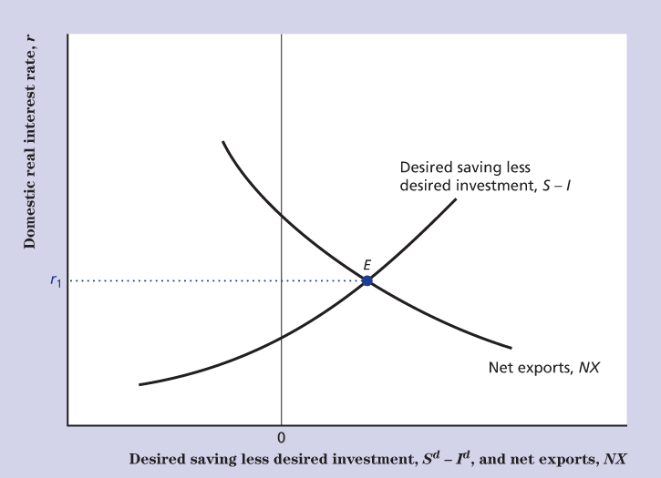
The Open-Economy IS Curve (3 of 5)
Figure 10.3 Goods Market Equilibrium in an Open Economy

Slide 37
The Open-Economy IS Curve (4 of 5)
Suppose that output rises
S^{d} increases, S^{d} > I^{d}, the S−I curve shifts to the right
Import rises, NX falls, and the NX curve shifts to the left
Equilibrium is restored with lower r
IS curve slopes downward

Slide 38
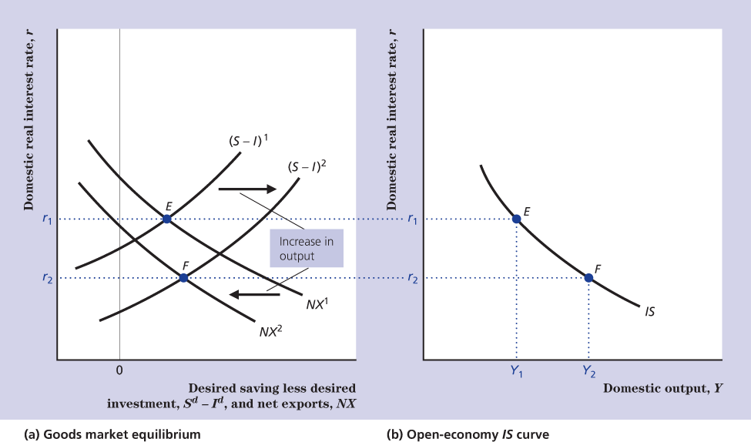
The Open-Economy IS Curve (5 of 5)
Figure 10.4 Derivation of the IS Curve in an Open Economy

Slide 39
The Open-Economy IS Curve Shifters
Any factor that changes the real interest rate that clears the goods market at a constant level of output shifts the IS curve.
Any factor that changes NX, given Y, will shift the open-economy IS curve.

Slide 40
The Transmission of Business Cycles
The impact of foreign economic conditions on the real exchange rate and net exports is one of the principal ways by which cycles are transmitted internationally.
A decline in US output shifts the Canadian IS curve down.

Slide 41
Macroeconomic Policy with Flexible Exchange Rates
Assume a small open economy
The exchange rate is not expected to change
r = r_{For}
Known as Mundell-Fleming model

Slide 42
A Fiscal Expansion and the Flexible Exchange Rate (1 of 2)
An increase in G crowds out NX because
Shifts the IS curve to the right
r is above r_{For}, the demand for Canadian financial assets increases
The e increases and the NX falls
IS curve shifts to the left where r = r_{For}
No change in Y and P (crowding out)

Slide 43
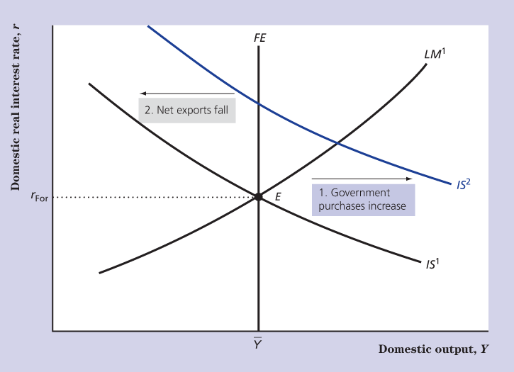
A Fiscal Expansion and the Flexible Exchange Rate (2 of 2)
Figure 10.7 An Increase in Government Purchases in A Small Open Economy With Flexible Exchange Rates

Slide 44
A Monetary Expansion and the Flexible Exchange Rate (1 of 4)
An increase in M
Shifts the LM curve to the right
r is below r_{For}, the demand for Canadian financial assets decreases
The e decreases and the NX rises
The IS curve shifts to the right where r = r_{For}

Slide 45
A Monetary Expansion and the Flexible Exchange Rate (2 of 4)
The Keynesian model predicts further adjustments in the LR
Y is higher than$\overline{Y}$, P increases
LM curve shifts to the left
r is above r_{For}, the demand for Canadian financial assets increases
The e increases and the NX falls
IS curve shifts to the left, where r = r_{For}

Slide 46
A Monetary Expansion and the Flexible Exchange Rate (3 of 4)
The Keynesian model predicts that in the long-run
A monetary expansion will result in a higher price level
No change in Y, r, NX, e
Thus, monetary neutrality holds
The money neutrality holds immediately in the classical model.

Slide 47
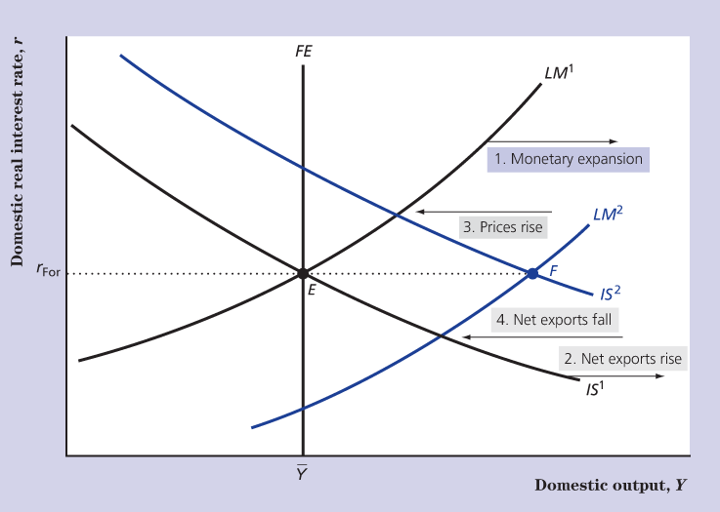
A Monetary Expansion and the Flexible Exchange Rate (4 of 4)
Figure 10.8 A Monetary Expansion in a Small Open Economy with Flexible Exchange Rates

Slide 48
Fixing the Exchange Rate
In a fixed-exchange-rate system, the value of the nominal exchange rate is officially set.
An overvalued exchange rate is a situation when an exchange rate (e_{nom}) is higher that its fundamental, or market determined value (e¹_{nom}).

Slide 49
Overvalued Exchange Rate (1 of 2)
In a situation of an overvalued exchange rate a government can
Devalue its nominal fixed exchange rate.
Restrict international transactions.
Buy back its currency in foreign exchange market.

Slide 50
Overvalued Exchange Rate (2 of 2)
To support the domestic currency the central bank must use reserves equal to the country’s balance of payment deficit.
It cannot do that forever because the amount of reserves is limited.

Slide 51
A Speculative Run
An attempt to support an overvalued currency can be ended by a speculative run.
To avoid losses, financial investors frantically sell assets denominated in the overvalued currency.

Slide 52
How to Support an Overvalued Currency
To support an overvalued currency a country could
Impose strong restrictions on international trade and finance.
Devalue its currency.
Make a policy change to raise the fundamental value of the exchange rate (use monetary policy).

Slide 53
Undervalued Exchange Rate
An undervalued exchange rate exists if the officially fixed value is lower than the fundamental value of the exchange rate.
Could be maintained indefinitely if a country trading partners would not lose their reserves.

Slide 54
A Monetary Policy and the Fixed Exchange Rate (1 of 2)
An increase in M
Shifts the LM curve to the right, r is below r_{For}
The exchange rate is overvalued.
A decrease in M
Shifts the LM curve to the left, r is above r_{For}
The exchange rate is undervalued.

Slide 55
A Monetary Policy and the Fixed Exchange Rate (2 of 2)
Under a fixed exchange rate the central bank cannot use monetary policy to pursue macroeconomic stabilization goals.

Slide 56
A Fiscal Policy and the Fixed Exchange Rate (1 of 3)
An increase in G
Shifts the IS curve to the right, r is above r_{For}
The exchange rate is undervalued
The monetary expansion required to fix the exchange rate accommodates the fiscal expansion
LM shifts to the right where r = r_{For}

Slide 57
A Fiscal Policy and the Fixed Exchange Rate (2 of 3)
e_{nom}, P and P_{For} are fixed in the short run and under the fixed exchange rate, e is fixed.
In the long run P increases, e increases, NX fall.
Eventually NX have been crowded out by the fiscal expansion.

Slide 58
A Fiscal Policy and the Fixed Exchange Rate (3 of 3)
In the classical model P and e increase immediately in response to the fiscal expansion and NX is immediately crowded out.
Under the fixed exchange rate fiscal policy is an effective tool for adjusting domestic output in the Keynesian short run.

Slide 59
Fixed versus Flexible Exchange Rates
Benefits of fixed-exchange-rate systems
Less costly trade in goods between countries
i.e. lower transaction cost
Promotes monetary policy discipline
The downside is inability of a country to use its monetary policy to deal with recessions.

Slide 60
Open-Economy Trilemma
In selecting an exchange rate system a country can choose only two of three features
A fixed exchange rate to promote trade
Free international movement of capital
Autonomy for domestic monetary policy

Slide 61
Fixed Exchange Rate System
Fixed exchange rates are useful when used in a group of countries.
Large benefits can be gained from increased trade and integration.
Monetary policies can be coordinated closely.

Slide 62
Flexible Exchange Rates System
A flexible exchange rate system is useful if a country has specific macroeconomic shocks.
Shocks can be reduced with help of monetary policy.

Slide 63
Currency Unions
A currency union is sharing of a common currency by a group of countries.
Reduces the cost of trading and prevents speculative attacks on currencies.
However, monetary policies cannot be independent.

Slide 64
The Self-Correcting Small Economy (1 of 3)
A small open economy has more sources of unexpected shocks.
However, if the exchange rate is flexible there also exists a correcting mechanism in addition to the price level—an exchange rate adjustment.

Slide 65
The Self-Correcting Small Economy (2 of 3)
A fixed-exchange-rate system
Neutralizes the effects of both fiscal policy and shocks to the IS curve
Monetary policy and shocks to the LM curve have a magnified impact

Slide 66
The Self-Correcting Small Economy (3 of 3)
A flexible exchange rate system neutralizes monetary shocks and magnifies effects of the fiscal policy.

