Slide 1

Macroeconomics
Ninth Canadian Edition
Chapter 11
Classical Business Cycle Analysis: Market-Clearing Macroeconomics
Copyright © 2022 Pearson Canada Inc.
Notes:
If this PowerPoint presentation contains mathematical equations, you may need to check that your computer has the following installed:
1) MathType Plugin
2) Math Player (free versions available)
3) NVDA Reader (free versions available)

Slide 2
Main Question
How are business cycles described in the classical model?
What is the role of money in the classical model?
What are the misperceptions theory?
How does rational expectation affect monetary policies?

Slide 3
Business Cycle in a Classical Model
We assume that prices and wages adjust rapidly.
So, the economy is in or near the general equilibrium.
A challenge of the classical theory of business cycle is a fact that the money stock leads the cycle when money should be neutral.

Slide 4
The Real Business Cycle Theory (1 of 3)
The real business cycle (RBC) theory argues that real shocks to the economy are the primary cause of business cycle.

Slide 5
The Real Business Cycle Theory (2 of 3)
Real shocks are disturbances to the real side of the economy
  Production function
  Size of the labour force
  Real quantity of government purchases
  Spending and saving decisions of consumers

Slide 6
The Real Business Cycle Theory (3 of 3)
Nominal shocks are shocks to money supply and money demand (affect LM curve in IS-LM model).
Productivity shocks (supply shocks) play the largest role in the real business cycle theory, they are the dominant form of economic disturbances.

Slide 7
Adverse Productivity Shocks (1 of 2)
An adverse productivity shock
  Reduces MPN
  The demand for labour falls
  Equilibrium employment level and real wage fall
  Equilibrium level of output falls
  The interest rate rises
  Consumption and investment rises
  The price level rises

Slide 8
Adverse Productivity Shocks (2 of 2)
In the RBC approach, output declines in recessions and rises in booms because
  The general equilibrium level of output has changed.
  Rapid price adjustment ensures that actual output always equal full-employment output.

Slide 9
RBC Theory and Business Cycle Facts (1 of 2)
Correct predictions of RBC theory
  Productivity shocks cause recurrent fluctuations in aggregate output.
  Employment is procyclical.
  Real wages are procyclical.
  Average labour productivity is procyclical.
  Saving and investment move closely in different countries.

Slide 10
RBC Theory and Business Cycle Facts (2 of 2)
Fact not explained by RBC theory
  Inflation tends to slow during or immediately after a recession, contrary to the prediction of inflation.

Slide 11
Are Productivity Shocks the Only Source of Recessions?
The assumption of RBC theorists that productivity shocks are the only source of economic fluctuations is criticized by both Classicals and Keynesians.
The RBC theorists’ response is that a series of small shocks can cause large fluctuations.

Slide 12
The Solow Residual and Technology Shocks (1 of 5)
The most common measure of productivity shocks is the Solow residual, an empirical measure of total factor productivity, A.
The Solow residual is procyclical.

Slide 13
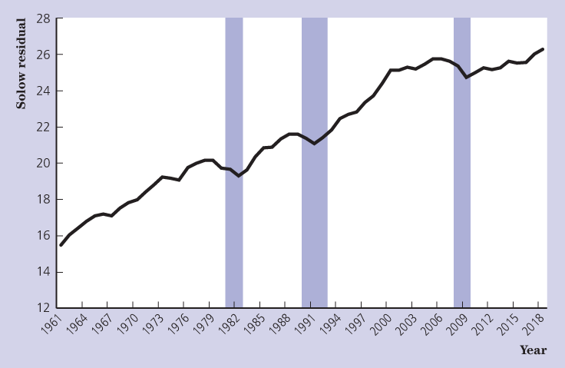
The Solow Residual and Technology Shocks (2 of 5)
Figure 11.4 Canadian Solow Residuals, 1961-2018

Slide 14
The Solow Residual and Technology Shocks (3 of 5)
Many question the interpretation of the Solow residual as a measure of technology.
Some statistical studies reveal that it is also correlated with such factors as government expenditures.

Slide 15
The Solow Residual and Technology Shocks (4 of 5)
Capital and labour can be used with different utilization rates u_{K} and u_{N}.
The evidence of utilization of both capital and labour is procyclical.

Slide 16
The Solow Residual and Technology Shocks (5 of 5)
Labour hoarding occurs when due to the cost of hiring and firing workers, firms retain some workers in a recession that they would otherwise lay-off.
Some economists find that technology shocks are acyclical due to lags.

Slide 17
Fiscal Policy Shocks in the Classical Model (1 of 6)
Classical economist argue that an increase in government purchases will not only shift IS up but may also shift the FE line to the right.
If so, an increase in government purchases causes full employment output Y to increase.

Slide 18
Fiscal Policy Shocks in the Classical Model (2 of 6)
In the classical model, fiscal policy might shift the FE line and so affect real output through the possible effect that a change in government purchases has on wealth.

Slide 19
Fiscal Policy Shocks in the Classical Model (3 of 6)
If government increases the share of the nation’s output for public spending, then people may feel their wealth has been reduced.
Decrease in wealth increases labour supply of workers and therefore, increases the equilibrium level of employment and the full employment level of output.

Slide 20
Fiscal Policy Shocks in the Classical Model (4 of 6)
Increase in employment reduces the average labour productivity because of diminishing marginal productivity of labour.

Slide 21
Fiscal Policy Shocks in the Classical Model (5 of 6)
Weak correlation between GNP and the average labour productivity in the data implies that classical economists can claim an increase in government purchases lowers the wealth of individuals and so, causes them to increase their supply of labour.

Slide 22
Fiscal Policy Shocks in the Classical Model (6 of 6)
Classical assumption is difficult to make!
In practice, an increase in government purchases may have no effect or even positive effect on private wealth.

Slide 23
Fiscal Policy and the Cycle
Increased government spending may make workers worse-off and forces them to increase their supply of labour.
Government spending should be used to stabilize the economy only when the benefits of doing so exceed the costs.

Slide 24
Unemployment in the Classical Model (1 of 3)
In the simple classical model unemployment is zero, but in reality it is not.
Differences among workers and jobs explain not only why the unemployment rate is always greater than zero, but also why it rises so sharply in recessions.

Slide 25
Unemployment in the Classical Model (2 of 3)
Many economists believe that the dynamic reallocation of workers between sectors is an important source of unemployment.

Slide 26
Unemployment in the Classical Model (3 of 3)
Classical economists point out that fiscal policy cannot directly address the microeconomic level problem arising from the mismatch.

Slide 27
Monetary Policy and the Economy (1 of 2)
Classical economists view money as neutral for any time horizon.
The fact that money is a leading procyclical variable is inconsistent with the predictions of the classical model.

Slide 28
Monetary Policy and the Economy (2 of 2)
Classical economists argue that reverse causation can explain the procyclical behaviour of money.
Reverse causation means that expected future increases and decreases in output cause increases and decreases in the money supply.

Slide 29
The Evidence on the Nonneutrality of Money
Reverse causation cannot explain the entire relationship between money and real income. Friedman and Schwartz found that:
  money is procyclical;
  monetary changes have an independent origin.

Slide 30
The Misperceptions Theory (1 of 6)
Most economists believe that money is not neutral.
The misperceptions theory implies that the SRAS curve is upward sloping even when prices adjust quickly.

Slide 31

The Misperceptions Theory (2 of 6)
The misperception theory says that the aggregate quantity of output supplied rises above the full-employment level, $\overline{Y}$ when the aggregate price level, P, is higher than expected.

Slide 32
The Misperceptions Theory (3 of 6)
The aggregate supply curve relates the aggregate amount of output produced to the general price level.
A producer does not know the general price level and forms expectations of it.

Slide 33
The Misperceptions Theory (4 of 6)
If an actual price level, P, rises above the expected price level, P^{e}, the producer responds by producing a higher level of output,
where b is a positive number that describes how strongly output responds when P > P^{e}.

Slide 34
The Misperceptions Theory (5 of 6)
The short-run aggregate supply curve applies to the period of time when the price level has yet to fully adjust.
In the long run, people learn what is actually happening to prices and the expected price level adjusts to the actual price level.

Slide 35
The Misperceptions Theory (6 of 6)
In the long-run the observed price level turns out to be what was expected.
The SRAS must always intersect LRAS at the expected price level.

Slide 36
Aggregate Demand And Aggregate Supply Equilibrium (1 of 2)
The reason to introduce AD-AS model is to relax the assumption that “what households and firms expect to see and experience in the future is not affected by what they see and experience today.”

Slide 37
Aggregate Demand And Aggregate Supply Equilibrium (2 of 2)
We now allow current events, including the announcements of policymakers, to influence how households and firms make plans with respect to their consumption, investment, and employment choices.

Slide 38
Rational Price Expectations (1 of 2)
The hypothesis of rational expectations states that the public’s forecasts of various economic variables, including the price level, are based on a reasoned and an intelligent examination of available economic data.

Slide 39
Rational Price Expectations (2 of 2)
The rational price expectation is formed given the expected position of the aggregate demand curve.
If the expectation is correct, the actual price level will correspond to the expected price level.

Slide 40
Monetary Policy and the Money Supply
Unanticipated changes in money supply have real effects in the short-run, but anticipated changes are neutral and have no real effects.

Slide 41
Unanticipated Changes in the Money Supply (1 of 2)
Suppose the Bank of Canada increases M, unexpectedly and without publicity.
The AD curve shifts up, the short-run equilibrium price level increases.

Slide 42

Unanticipated Changes in the Money Supply (2 of 2)
Y exceeds $\overline{Y}$, money is not neutral.
In the long-run people learn about true prices, adjust their P^{e} and equilibrium P goes up.

Slide 43
Anticipated Changes in the Money Supply (1 of 2)
Suppose the Bank of Canada announces an increase in M.
The AD curve shifts up.

Slide 44
Anticipated Changes in the Money Supply (2 of 2)
The expected price level rises, the SRAS curve shifts up, and equilibrium P goes up.
Y is not affected, money is neutral.

Slide 45
Rational Expectations and the Role of Monetary Policy (1 of 2)
Any unanticipated change in aggregate demand will affect output.

Slide 46
Rational Expectations and the Role of Monetary Policy (2 of 2)
Those who suggest that monetary policy should not be used as stabilization policy argue:
  expectations adjust quickly;
  prices adjust quickly;
  and so economic fluctuations are short-lived.

Slide 47
The Effects of Unanticipated Changes in AD
In reality shifts in aggregate demand last more than several weeks.
Classical economists stress the role of propagation mechanism, which is an aspect of the economy that allows short-lived shocks to have relatively long-term effects.

